Slide 1

CALL TO ACTION
Help Raise Funds for Test Method Development for Industrial Hemp Fibers
Pitchdeck for Silent Auction
Working Group
ASTM D37.07 WK87041
ILS-1862
Do you agree that the hemp fiber industry needs modern, efficient methods and standards to grow to its fullest potential and become a serious commodity in regional and global markets?
We are asking everybody in the worldwide hemp industry to contribute and those who want the industry succeed. You can help make that happen by offering products and services for our silent auction that will raise the required funds for test method development.

Slide 2
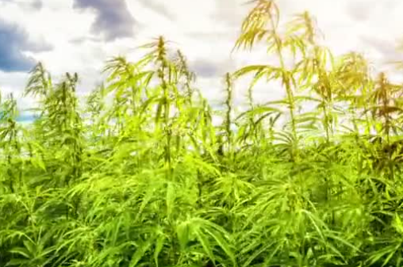
Silent Auction to Fund ASTM D37.07 Hemp Fiber Test Method Development
Silent Auction Goals
Raise funds to support the ILS #1862 feasibility study on hemp fiber length and width methods. Goal is to include >20 separate donations, plus option of cash donations, for a total of raising at least $20,000. Cash donations not tied to auction items, will receive a gift and certificate of gratitude. Additionally, the silent auction aims to launch an education and outreach campaign to highlight the hemp fiber industry and educate consumers, manufacturers, and regulators about hemp raw ingredients and finished products already in the marketplace. (Note: If we don't get enough items or value (min. 12 items, combined value >$15k) the silent auction will be postponed.) Auction via 32auction.com Tentative auction date: early April 2025.
Examples of donations (products & services): hemp fiber garments (shirts, caps, socks, etc.), books, antique hemp-related items, tour of facility or farm (lodging and food provided), hemp seed or oil, etc.
ASTM D37.07 Hemp Fiber Working Group Objective
This Hemp Fiber Working Group (ASTM ILS project 1862) plans to test, compare, select/prioritise and standardize test methods to make them part of international compendial standards through the ASTM organization.

Slide 3
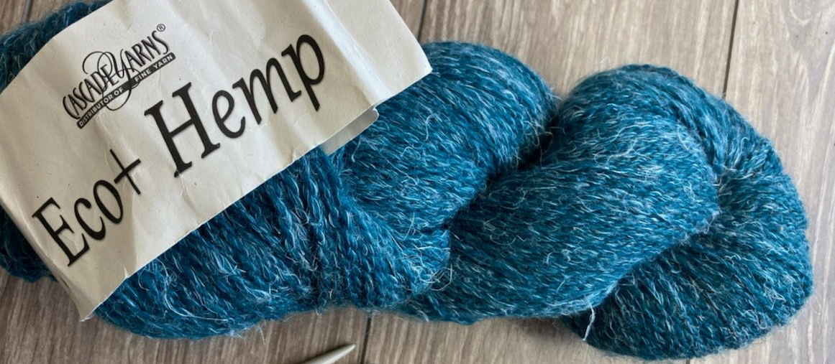
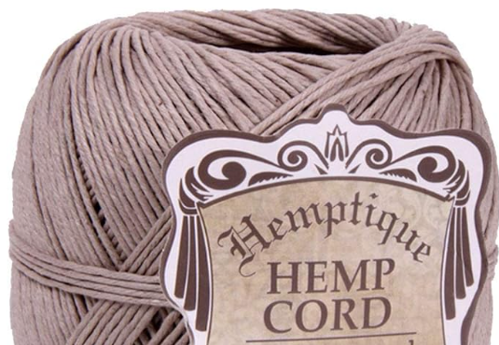
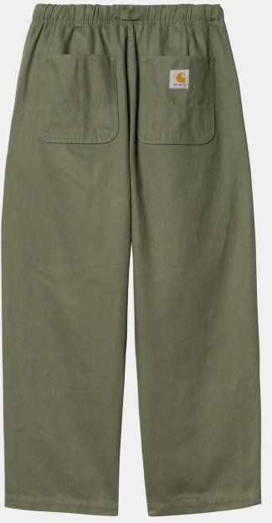
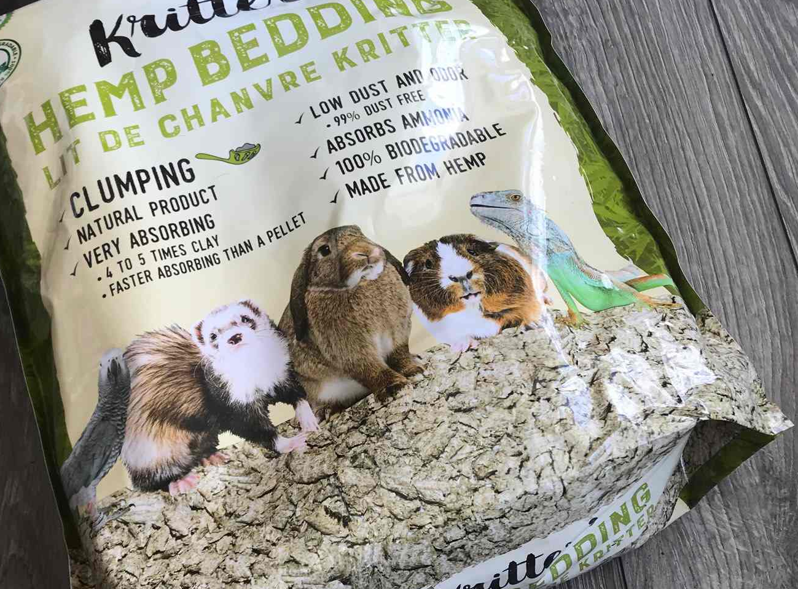
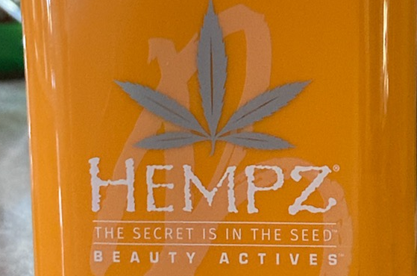
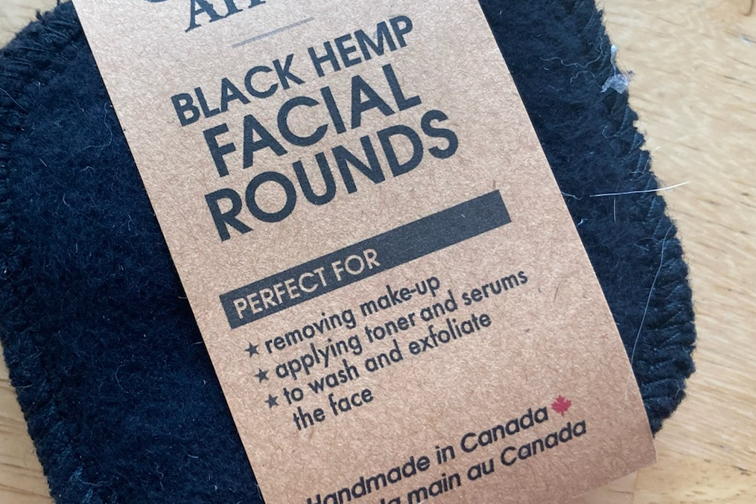
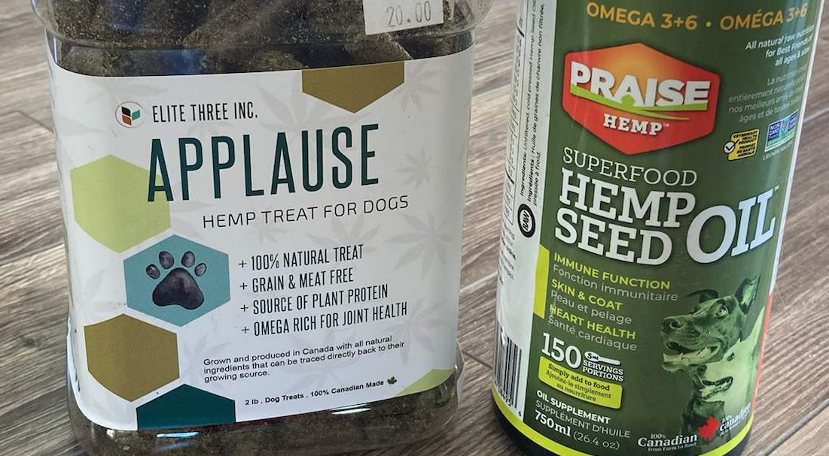
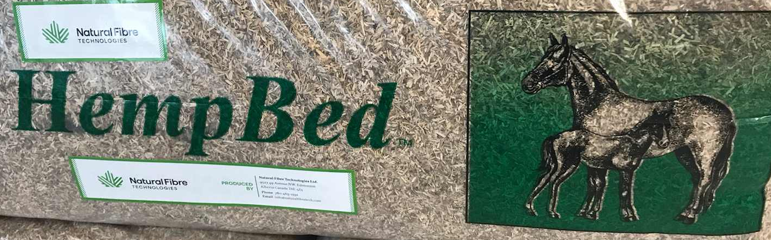
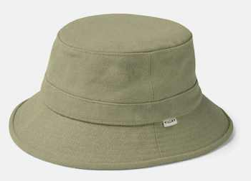
Benefits to Silent Auction Product Donors and Sponsors
Advertisement for your products
  Social media posts featuring your products
  Networking in industrial hemp associations: FIHO, CHTA, and ASTM
  Press releases
  Through silent auction host/software
Education about industrial hemp
Recognition of your support in our working group/method development updates
Cost to you: value of your item (product or service) and shipment
ROI = amazing
Images are examples

Slide 4
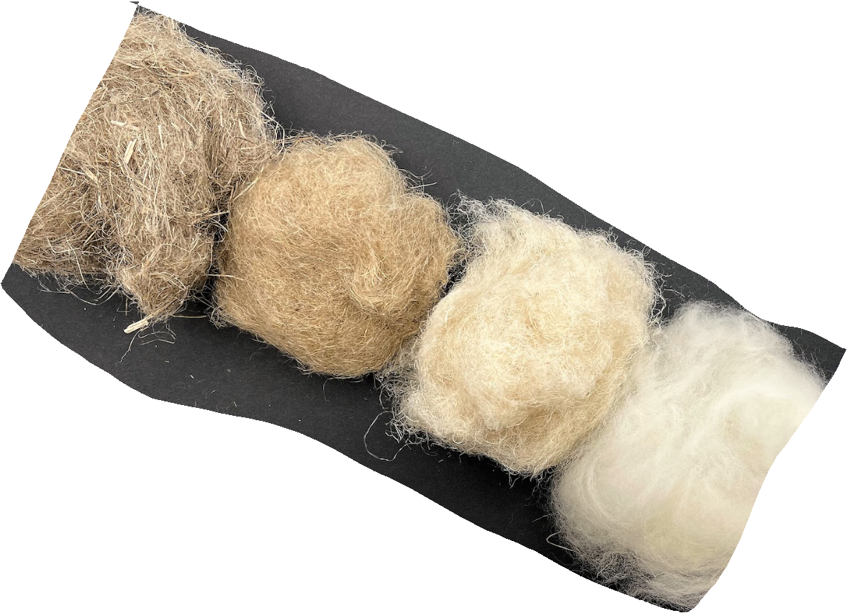
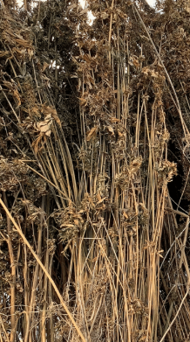
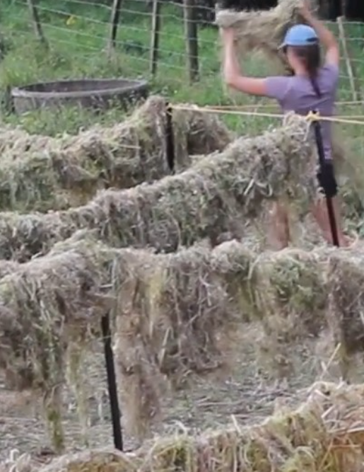
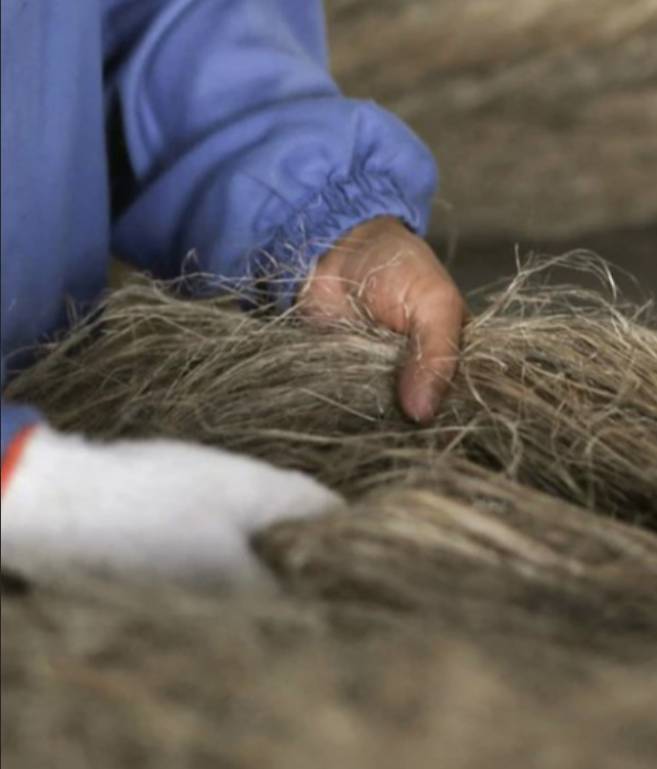
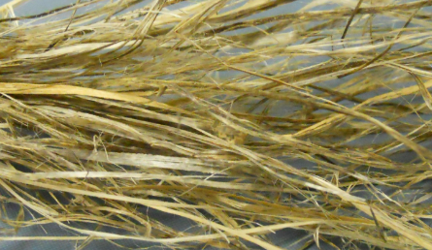
Silent Auction to Raise Funds for
Hemp Fiber Test Method Development
WK87041, ILS# 1862
Feasibility Study of Potential Methods
Evaluating and Comparing Several Test Methods for Each Hemp Fiber Property of Length and Width (and others)

Slide 5
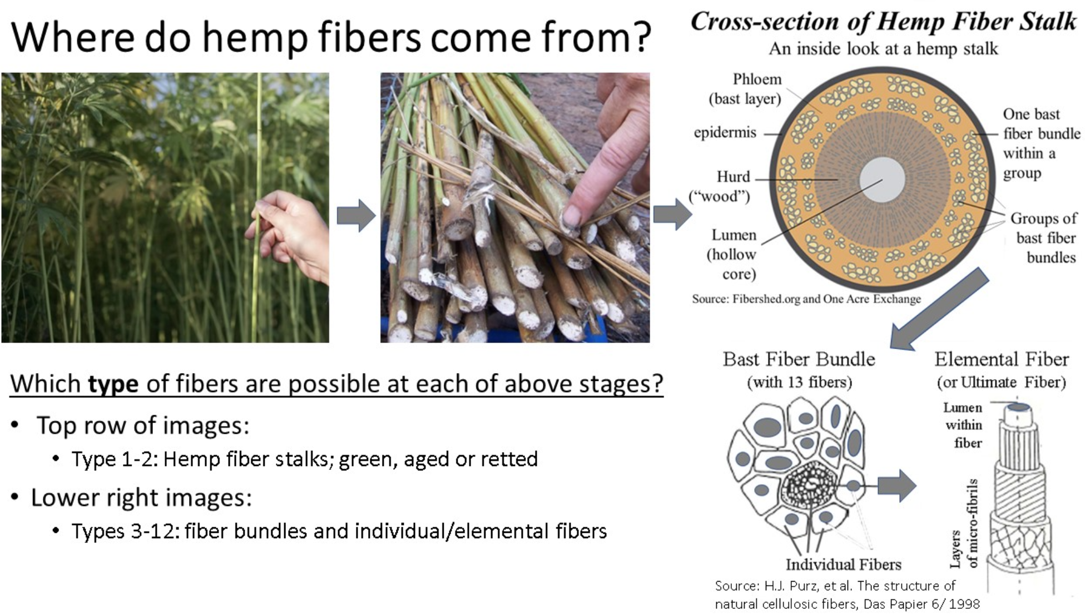
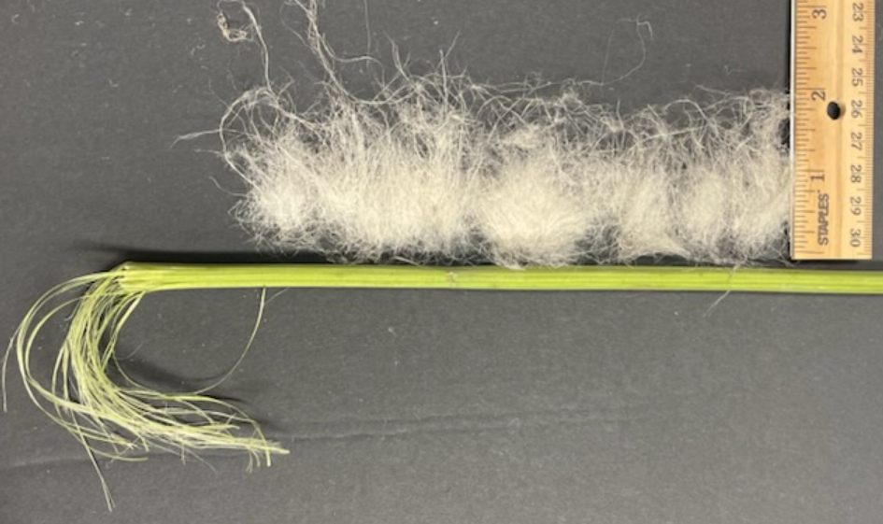
Bast 🡪 Ribbons 🡪 Fibers
Notes:
Hemp stalk (straw) 🡪 Bast 🡪 Hemp ribbons (thick bundles) 🡪 “Fibers” 🡪 Elemental Fibers (Ultimate Fibers)

Slide 6
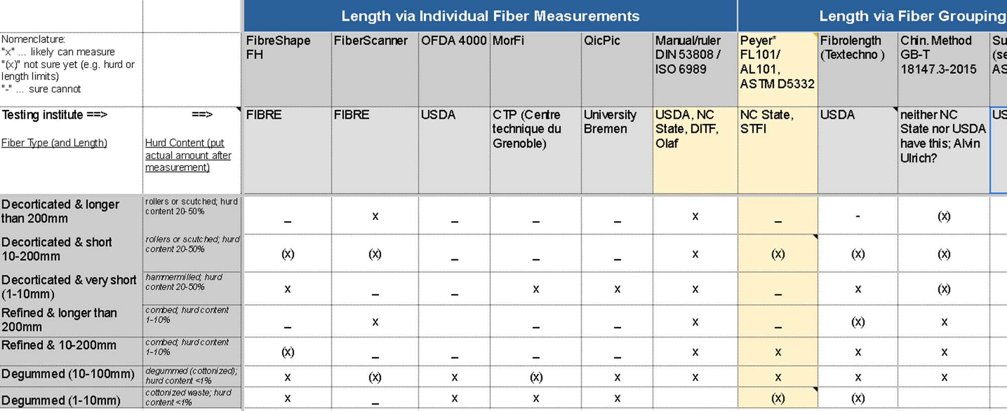
Global Review of Hemp Method Candidates
Across hemp fiber types and possible methods (excerpt for Length)

Slide 7
ILS Study: Large Number of Lab Variables
Sample Preparation
  How is sample taken from a lot
  How is specimen from sample prepared for a specific test method (e.g. separate fiber bundles)
# of Properties:
  Several properties are of high/urgent interest: Length, Width, Strength, …
# of Methods:
  Each property can be measured by several different test methods
# of Labs:
  Intention to pick at least 1 lab per method, but often include 2-3
# of Samples:
  Cotton-like hemp fibers can be done with “cotton methods”, but how about very long and coarse fibers with significant amount of hurd (shiv) still in it?
  Test the limits and “what would have to be true/done so that it could be measured with method X…”

Slide 8
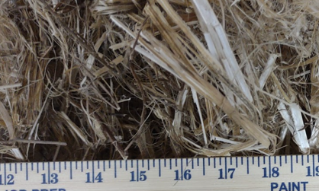
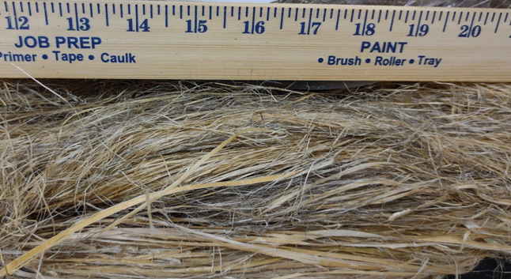
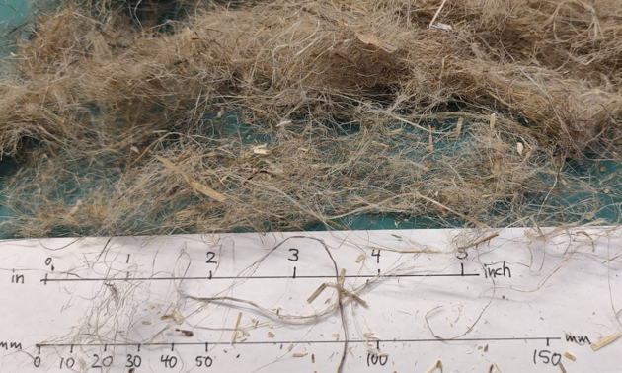
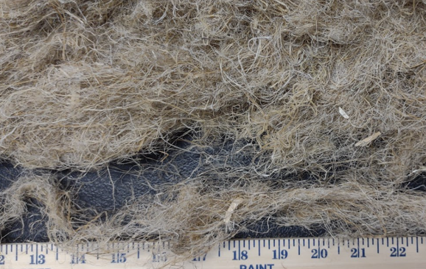
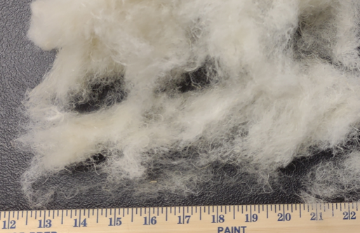
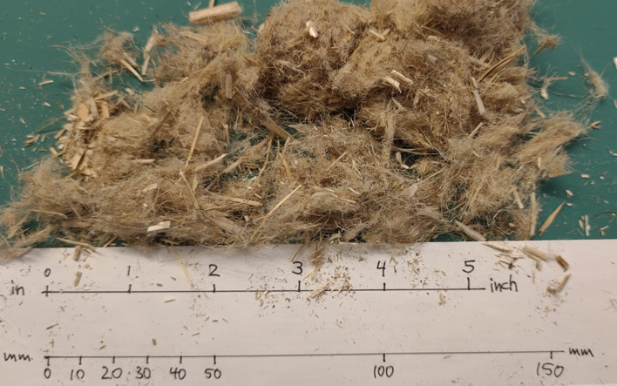
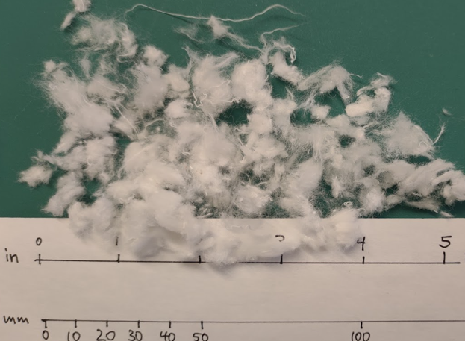
Samples (for Evaluating the Limits)
Length | DECORTICATED (1-3) | REFINED (4-5) | DEGUMMED (6-7)
Long
Short
Very Short
Cleanliness (Much to Little Hurd)
These do not exist, because fiber bundles are individualized into short elemental/ultimate fibers
Length of “Fibers” (Ribbons)
These exist, but no sample needed for our feasibility study

Slide 9
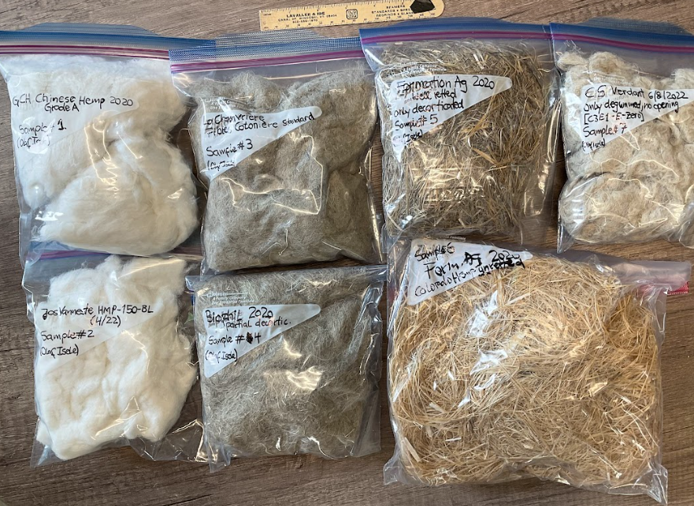
Sample Bags sent to Participating Labs

Slide 10
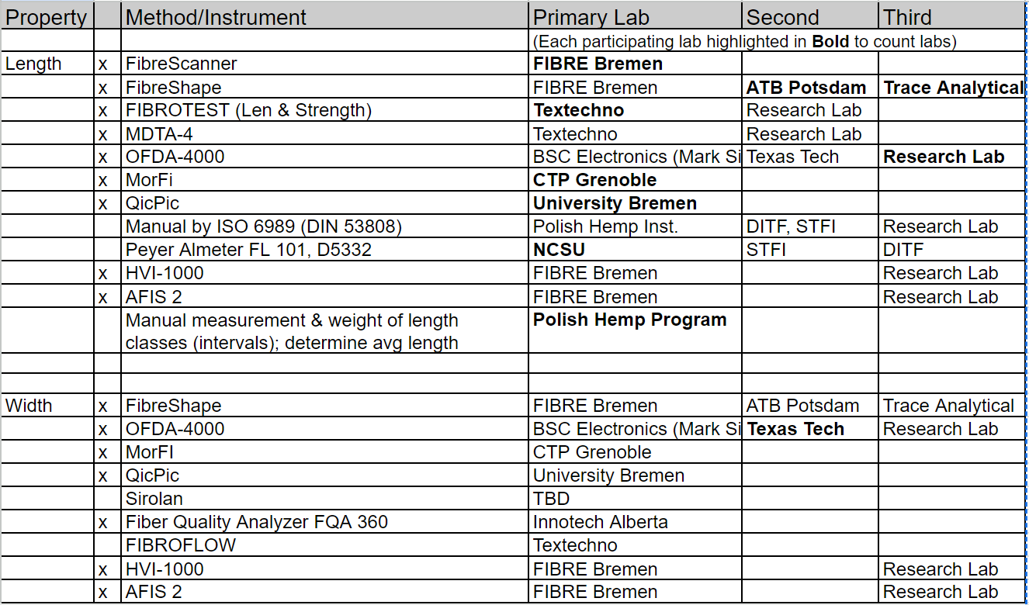
Example: Length and Width Test Methods and Labs
X=potential candidate

Slide 11
Work Done So Far & Work to be Funded
What have we done so far and why do we need funds to continue that work?
We identified the most relevant properties that organizations along the supply chain of hemp fiber from farm to fibers and applications are needing.
Reviewed literature and compendia worldwide to find the most suitable methods for those properties.
Found a dozen laboratories worldwide that have the capabilities for at least one of those test methods
Samples have been collected that represent the full range of coarse bast fiber bundles to cottonized and fine individual hemp fibers. Hand-delivered some of the samples to some labs but need to ship them to several more labs.
Planned Work
Send out remaining samples to labs in Australia etc. ($1000)
Finalize sample preparation protocol
University labs and test method equipment producers need to receive fees for carrying out the testing of the samples with equipment that they have, that is a major portion of the funding that we need. ($12,000)
Contact us [here] for learning more about our silent auction and our work. Participants will be advertised at our meetings and presentations at conferences etc.

Slide 12
Our criteria for selecting method from this feasibility study:
Note: Today’s ongoing quality control is done using manual methods such as ruler for length and microscope or gravimetric for width. This is too expensive (time-consuming), data-poor, and just obsolete.
Accuracy of results (new methods will be compared to “manual”)
Total testing time: sample preparation + analysis time, i.e. efficiency
# of data points for statistics
# of samples that can be tested (with samples “as is”)
Cost (equipment, license fees, annual operating cost)
Maintenance:
  e.g. impact of trash/dust, ease of cleaning
  Training, problem-solving service, …
Availability world-wide

Slide 13
For more information:
If you are interested in helping with our silent auction, please contact us:
  Product & service donations: contact Hunter, Lelia, Olaf
    hunter@agpolicysolutions.com, LLawson@daveytextiles.com, olaf@tracefemcare.com
  What we need from you is: item name, description, image, value/minimum bid value, description of your company, your website, your contact info (for the winning bid)
  Direct cash donation: FIHO
FYI:
Format of auction (via 32auction) will be selected after initial donations
  Auction format options: LINK
Target date for auction: early April 2025

